Slide 1
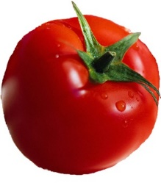
Specialty Crops Inspection Division
Overview of
Inspection Services

Slide 2
Specialty Crops Inspection Division
Specialty Crops Inspection Division (SCI)
Facilitates marketing of fruits, vegetables, and other specialty crops by providing:
Grading, inspection, and certification services
Voluntary, audit-based services to verify good agricultural and manufacturing practices
U.S. grade standards, grading manuals, inspection aids, color guides, and Commercial Item Descriptions for fruits and vegetables
Notes:
The USDA Specialty Crops Inspection Division provides outstanding quality assurance and food safety services.
Our mission is to support the global specialty crops market by collaborating with the agricultural community to provide trusted, impartial, prompt, and accurate quality assurance and food safety verification services.
SCI is a user-fee based organization which means we receive no appropriated money. We operate through the collection of fee’s we charge to the requestor (Applicant), for the services provided. Because of this, we work hard to be efficient and fiscally responsible.

Slide 3
Delivering to Our Stakeholders
Each year SCI:
Inspects and certifies billions of pounds of fresh and processed fruits, vegetables, and related products
Inspects $500 million of fresh and processed products for the
AMS Commodity Procurement Program
Ensures the quality of U.S. military rations
Conducts more than 4,000 food safety verification audits
Issues more than 200,000 export certificates
Maintains 313 U.S. standards for grade
Reviews 1,700 Child Nutrition Labels
Notes:
SCI delivers a wide range of services to our customers on fresh and processed fruits and vegetables throughout the commercial supply chain.
One example applies to Section 8e inspections.
These are inspections required of certain imported goods coming into the US to certify minimum quality standards. These inspections ensure international entities adhere to the same US quality and grade standards as US producers.
Take Table Grapes, for example.
Inspections ensure minimum quality requirements for domestic and imported grapes.

Slide 4
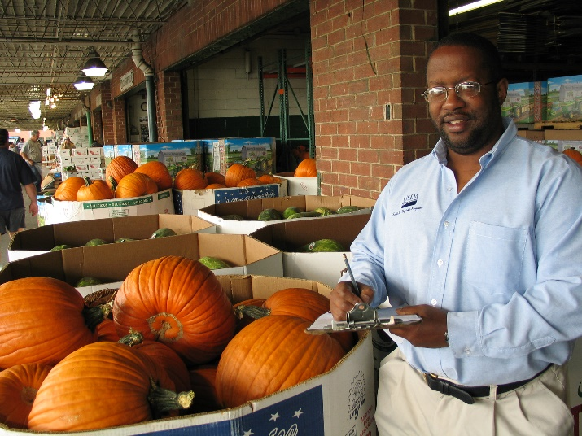
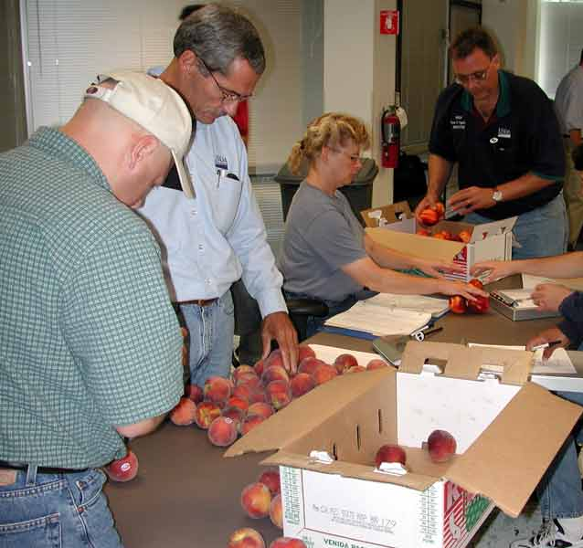
SCI’s Workforce
  700+ Federal employees
  2,500 State cooperators
  42 field locations
  Headquarters in Washington, DC
Notes:
SCI is comprised of more than 3,000 Federal and Federal/State employees who are located across the country and in Puerto Rico.
Our graders provide a range of services to our customers and anyone who has a financial interest in the product.
A typical load of product includes a supply chain of Grower-Packer-Broker-Trucker-Distributor-Receiver-Buyer.
Any of these entities can obtain an inspection for quality and condition factors.
Quality factors are things that do not change with time, including the size.
Condition factors are things like decay and bruising which can get progressively worse with time.

Slide 5
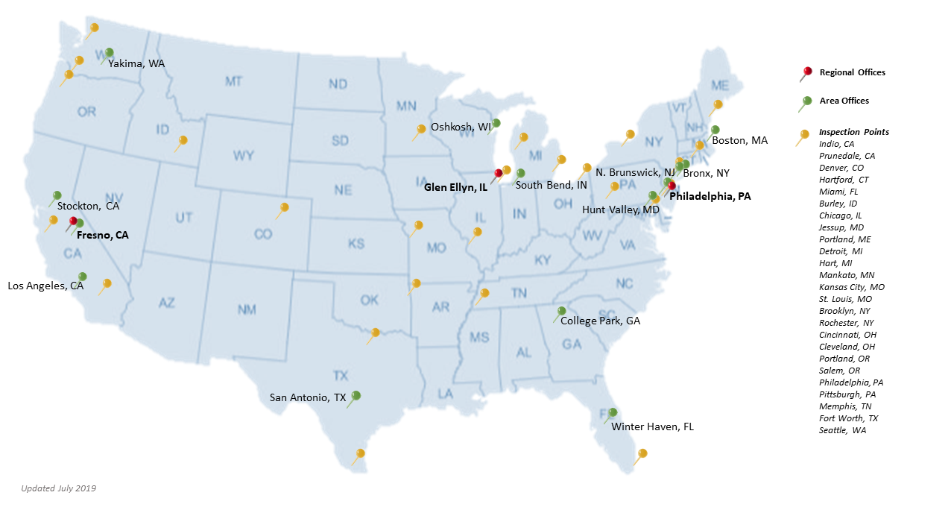
SCI Field Locations
Notes:
Our inspectors and auditors may be closer to you than you think.
Federal employees currently are located at 42 inspection points including 25 sub-offices, supervised by 14 area offices, all overseen by three regional offices.

Slide 6
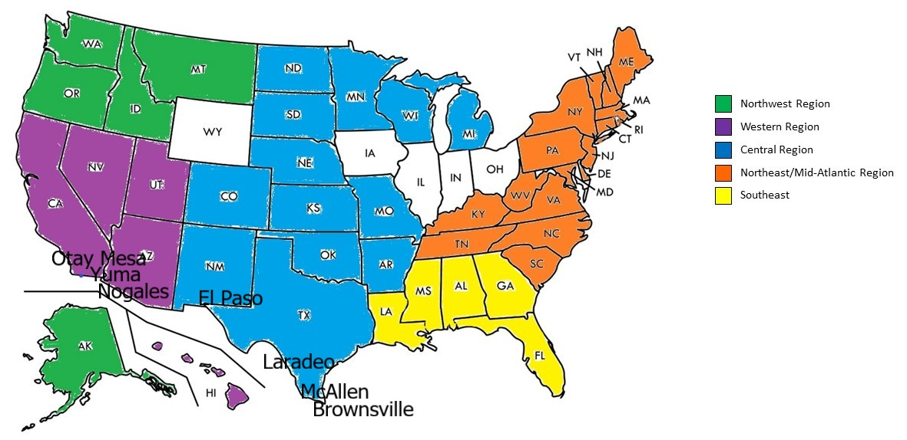
Inspection Border Crossings
Notes:
We work with most State Departments of Agriculture through cooperative agreements to license approximately 2,500 state personnel to perform inspection and auditing services on USDA’s behalf.
These Federal-State cooperators provide inspections at all major southern ports of entry, including San Diego (Otay Masa),California; Nogales and Yuma, Arizona; and El Paso, Laredo, McAllen, and Brownsville, Texas.

Slide 7
U.S. Standards for Grade
U.S. Standards for Grades
  Define quality and condition factors for fresh and processed fruits, vegetables, nuts, and other specialty crop products
  Provide a uniform common language for describing the quality and condition of commodities in the marketplace so consumers get the quality of product they want
  Serve as the framework for USDA inspection and grading services
Notes:
Grade Standards
USDA quality standards are the foundation of worldwide commodity communication and trade.
Standards provide uniform definitions for determining levels of quality – these quality distinctions translates into it’s value. The quality level helps establish the price that the buyer is willing to pay the seller. Lower quality grade products normally sell at lower prices than higher quality grade products.
They provide a common language for trading where the commodity cannot be readily displayed or examined by the prospective buyers, sellers, etc.
They communicate necessary, or required, information to buyers, sellers, & end users such as size, color, maturity, soluble solids, etc.
They provide standard terminology that can be used in marketing. Specific terms that have uniform specific meanings such as Large = 70 mm or larger.
And they provide a means of marking official quality levels (grades) on product labels.
When a truck load of product is sold across town, across the country or around the world, the grade U.S. No. 1 or US Combination communicates to all parties the quality they should expect, and establishes the value.
Standards are completely voluntary and are requested by the industry to help market the quality of their products. When an industry requests a grade standard or a revision to a grade standard, a team of Specialty Crops Inspection Division works with the industry using a transparent process that elicits public comments. SCI reviews these standards to ensure they reflect current market practices and needs, and to assess whether revisions are warranted based on specified criteria, such as changing industry practices. The grades should reflect the marketing practices of the industry. Standards generally include several grades of various quality to meet the diversity of the market. The end aim is to bring to consumers the quality of product they want.

Slide 8
U.S. Standards for Grade
Grade assigned to fresh tomatoes depend on various attributes including size (if the box is marked with a size) scaring, bruising, soft or decay and other quality or condition defects.
Grades for fresh tomatoes are U.S. No. 1, U.S. Combination, U.S. No. 2, and U.S. No. 3
Notes:
Other uses for grade standards are to help establish loan values for products in storage and to assure that products purchased by the Government (for example, by the School Lunch Program) are of acceptable quality.
In addition, private procurement agencies restaurants, shipping lines, and other feeding establishments as well as Federal and State government agencies, use the grade standards as specifications in purchasing foods.
Contracts between packers or processors and producers are often based on the grade of the product as delivered to the processing plant, and processors use the standards as aids in quality control.
Trading of food products on the futures market is also often based on official grades.
Grades are differentiated based on a combination of the allowance allowed for specific defects, or the size/seriousness of specific defects. Criteria are divided into 3 categories US no 1 scored against Damage, US no2-Serious Damage and US No. 3-Very Serious Damage. Combination grade allow designated combinations of specific grades to be combined in the same container. E.g. 70% US no1 and 30% USNo.2 being the most common.

Slide 9
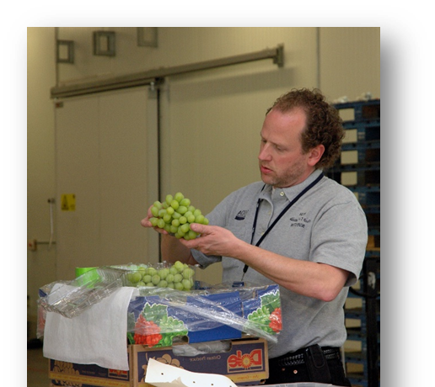
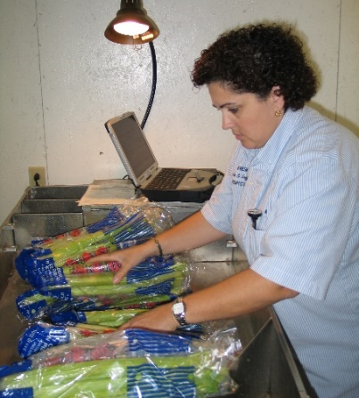
Inspection Services
Inspect fresh fruits, vegetables, nuts, and specialty crops products
Certify grade, quality, quantity, and condition
of product upon shipping or at destination in interstate commerce
Customers choose inspection type
  U.S. grade standards
  Contract terms
  Full inspection (quality and condition)
  Condition only
  Weight or count only
  Temperature only
Notes:
We certify grade, quality, quantity, and condition of product upon shipping or destination in interstate commerce. These include fresh fruits, vegetables, nuts and other types of specialty crops such as Christmas trees and fresh cut flowers.
Our customers choose the type of inspection service performed, when not mandated by a regulation. Such as products covered by section 8(e ) of the Agricultural Marketing Act of 1937
or other import requirements (i.e. Tomato suspension agreement).

Slide 10
Inspection Process
Truck with subject tomatoes from Mexico arrives at U.S. border
At importer’s request, U.S. Customs provides conditional release of the load
Truck crosses border and goes to a designated warehouse facility
Importer calls local USDA/Federal-State inspection office to request inspection
USDA-licensed inspector provides inspection and certification
Load passes inspection and is released
Notes:
The bullets in this slide outline the general process for loads of tomatoes, subject to Marketing Orders or the Tomato Suspension Agreement (TSA), would follow when entering the US.
Loads failing to meet requirements of the TSA must be reconditioned “to meet all requirement as to defects and grade allowances of the TSA”
and re-inspected or returned to Mexico in their entirety.

Slide 11
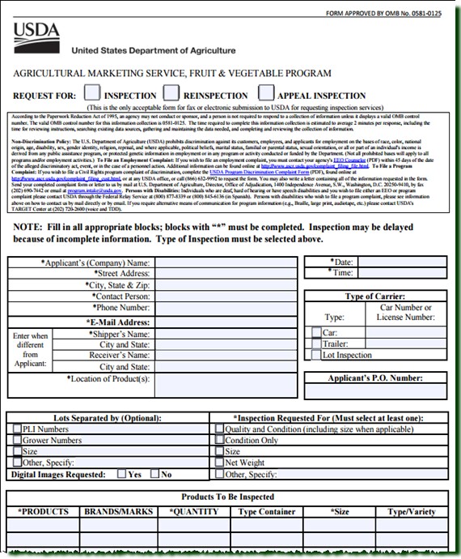
Requesting an Inspection
Use Form SC-237 https://www.ams.usda.gov/
resources/sc-237
Call, email, or fax your nearest inspection office directly
Find your servicing office at www.ams.usda.gov/services/
sci-contacts
Notes:
Now lets discuss the inspection request process. Service is not officially requested until it is documented on a SC-237 form.
You can submit a request verbally by calling the office closest to where the load is located and provided them with the required information. Or you can download the SC-237 on-line at https://www.ams.usda.gov/resources/sc-237 and email or fax the completed form to the inspection office.
Inspection office contact information can be found at www.ams.usda.gov/services/sci-contacts.

Slide 12
Requesting an Inspection
You cannot request an inspection on behalf of another applicant
Applicant will be billed for service
Be ready to provide the following information:
    Name of the product you want inspected, e.g. tomatoes
    Number of containers to be inspected
    Location of the product
    Lot, Purchase Order, or Bill of Lading number
    Inspection type or purpose
      Condition Only
      Quality and Condition
      Other, e.g., temperature only, net weight, or digital imaging
Notes:
When making the request for inspection, there are a few important points to keep in mind:
The party who will receive the certificate and be billed for the service is called the applicant. One applicant can not request an inspection on behalf of another applicant. This is due to billing and payment obligations.
Will need to enter the name of the product you want inspected and how many containers there are.
Location of the product (where does our inspector need to be).
Provide a lot number, a PO or Bill of Lading and or a Customs Entry number. This helps identify the lot when we get on site.
What type of inspection is needed.

Slide 13
Inspection Services
Under the Tomato Suspension Agreement, USDA will inspect all Round and Roma tomatoes (including Stem On), and grape tomatoes in bulk from Mexico
    When load is available for inspection, importer must request USDA inspection and pay associated USDA fees
The following fresh tomatoes are excluded from the inspection requirement: tomatoes on the vine, specialty tomatoes, and grape tomatoes in retail packages of 2 pounds or less
Notes:
In accordance with the 2019 Tomato Suspension Agreement, USDA Specialty Crops Inspection Division will inspect all subject shipments of tomatoes. The minimum quality requirement is US. No. 2.
Concurrently, during the period October 10 to June 15 U. S. import requirements will apply.
Loads containing multiple varieties and/or pack styles will be inspected as a separate lots against the appropriate Grade Standard.

Slide 14
Inspection Services
USDA inspector generally completes inspection within
48 hours of receiving an importer's official request for inspection
If already stationed in the area, a USDA inspector generally completes inspection within 24 hours of the official request for inspection by the importer
Notes:
In most cases inspections will be completed the same day they are requested.
Offices located at most southern ports of entry, such as San Diego, Nogales and in TX are accustomed to high volumes and do not anticipate any issues meeting the stated timeline.

Slide 15
Inspection Services
USDA and Federal – State cooperators perform inspections
Inspection must be unrestricted
Inspection based on US standard for fresh tomatoes and greenhouse tomatoes using shipping point tolerances
All tomatoes must grade at least U.S. No. 2
Notes:
USDA will perform inspections (an unrestricted certification) in accordance with its normal practice to determine quality, condition, and grade pursuant to the appropriate USDA standard covering fresh tomatoes and greenhouse tomatoes and using shipping point tolerances.
Unrestricted means that all portions of the load and or lot(s) have been represented in sampling. They are not restricted to specific pallets of layers of a load or lot, i. e. 2 pallet nearest rear doors of the trailer or upper 3 layers of pallets..

Slide 16
Inspection Services
Marketing Order 966/8e Import Requirements | Signatory Agreement
 | Fresh Tomatoes Standard | Greenhouse Standard
Minimum Requirements: U.S. No. 2, 2-9/32 | Minimum Requirements: U. S. No 2 | Minimum Requirements: U. S. No 2
Size 2-9/32 10% Tolerance | Must meet size or count if marked 10% Tolerance | Must meet size or count if marked 10% Tolerance
Defects: TOTAL DEFECTS: Serious Damage 10% Including 5% very serious damage (vsd) Included in vsd -1% soft of decay | Defects: TOTAL DEFECTS: Serious Damage 10% Including 5% very serious damage (vsd) Included in vsd -1% soft of decay | Defects: TOTAL DEFECTS: Serious Damage 10% Including 1% soft of decay Note: the following defects are more restrictive in the Greenhouse Standard: Mature: external color shows at least a definite break from green…. on not less than 10% of the surface. Form is more restrictive
Notes:
This shows the minimum requirements for Tomatoes covered by the Marketing Order and the Tomato Suspension Agreement

Slide 17
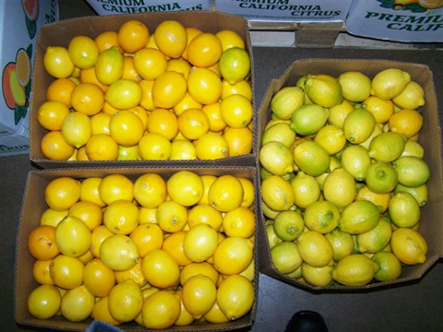
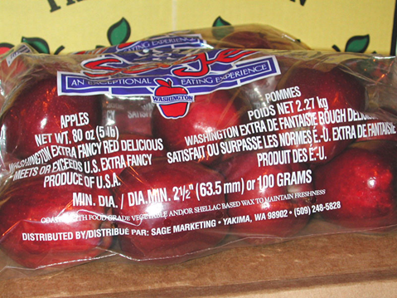
Sampling
Samples taken to determine defects present and grade
Number of samples required depends on variations in inspection conditions
  At least 1% of containers
  in a lot must be sampled
Number of samples must be sufficient to ensure that the certificate accurately describes the quality and condition of the lot
Notes:
Everything we report is based on representative sampling (samples that represent all portions of the lot or load). These samples determine the defects present and the over all grade of the lot.
A sample can be a carton, a flat, a lug, a crate or a consumer unit-such as bagged apples. No exact rule can define the number of samples that must be examined because of the variations in inspection conditions. However, our goal is to sample a minimum of 1% of the containers in a lot. This number may be larger or smaller depending on the amount of defects in the lot. Very low or very high percentages of defects may change the sample number to less or more than 1%, respectively.
Our inspectors examine enough samples to ensure that the certificate issued will accurately describe the quality and condition of the lot.

Slide 18
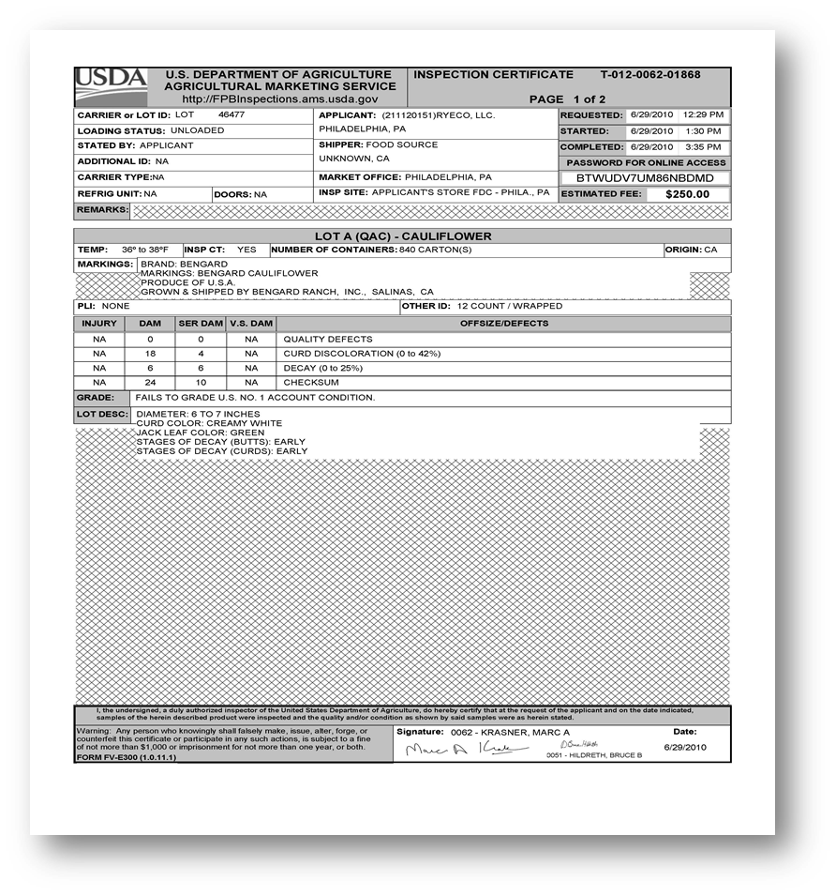
Certification
Certificate shows results of your inspection, including:
  Commodity and number of containers inspected
  Product temperatures
  Percentages of defects
  Grade statement, if applicable
  Fee for service
Most certificates are electronically created and distributed
Notes:
Once samples are analyzed and defects identified a certificate is issued which provides a summary of the results. Certificates can be issued electronically, or may be hand-written and delivered in person or by fax..
Certificates will list the important aspects of the lot such as commodity, number of containers, temperatures, percentages of defects and the fee.

Slide 19
Fees
USDA inspection services are provided on a fee-for-service basis
  https://www.ams.usda.gov/services/grading/fees
Most fees are determined on a “carlot” basis (e.g., a trailer load equivalent)
Mileage, overtime and holiday charges may be assessed, as applicable, based on the location, date, or time of the inspection
Notes:
As mentioned earlier, fees for all inspection services are charged directly to the customer requesting the service. As SCI is a user-fee funded Division, the inspection service is supported by the fees we charge. Our rates cover the costs of the federally mandated services only; we are NOT a for-profit operation.
Most fees are determined on a “carlot” basis for each commodity inspected, meaning that the number of containers in the lot at the time of the inspection indicates the cost. Carlot relates to a standardized trailer load equivalent amount, whether still loaded on the truck or racked in a warehouse.
Mileage, overtime and Holiday charges could be assessed based on location and date or time of the inspection.

Slide 20
Contact Us
Border Crossing Inspection Service Contacts
Nogales, Arizona
Contact: Shau Booker
Phone: 520-281-0783, extension 3
Fax: 520-337-9106
San Diego, California (Otay Mesa)
Contact: Charlie Priest
Phone: 916-661-6355
Fax: 916-661-6963
Alamo and Laredo, Texas
Contact: Noe Carreon
Phone: 956-787-4091
Fax: 956-783-0479
El Paso, Texas
Contact: Andres Sandoval
Phone: 915-309-1054
Notes:
For more information on our Inspection Services or to request service, please contact our professionals

Slide 21
Contact Us
For more information about – or to request –
SCI inspection services,
please contact your local office
www.ams.usda.gov/services/sci-contacts
or
SCI Inspection Operations
Specialty Crops Inspection Division
Telephone: 800-811-2373
Email: SCIinspectionoperations@usda.gov
Notes:
For more information on our Inspection Services or to request service, please contact our professionals

