Slide 2
Local Food Purchase Assistance (LFPA) Cooperative Agreement Program

Slide 3
PROGRAM OVERVIEW

Slide 4
Purpose and Authorization
The Local Food Purchase Assistance program maintains and improves food and agricultural supply chain resiliency through non-competitive cooperative agreements to State and Federally Recognized Tribal Governments.
States and Tribal Governments will enter into non-competitive cooperative agreements with USDA for the purchase of local domestic food targeting socially disadvantaged farmers and ranchers to be distributed targeting underserved communities.
Authorized and funded under Section 1001(b)(4) the American Rescue Plan Act (P.L. 117-2).

Slide 5



Three Overarching Goals
1
2
3
Provide an opportunity for States and Tribal Governments to strengthen their local and regional food system.
Help to support local and socially disadvantaged farmers/producers through building and expanding economic opportunities.
Establish, strengthen, and broaden partnerships with producers and the food distribution community, local food networks, and non-profits- distributing fresh and nutritious foods in rural, remote, or underserved communities.

Slide 6
How it will work
Procurement
State and Tribal Governments will procure domestic, local foods from local farmers and ranchers.
Targeted purchases from socially disadvantaged farmers and ranchers to expand existing local food networks.
Documented procurement procedures must be in place and consistent with applicable State, local, and tribal laws and regulations, and conform to the procurement standards identified in 2 CFR § through 2 CFR § 200.327.
Distribution
State and Tribal Governments will distribute the food within their State or region targeting underserved communities.
Distribution to communities not normally served through traditional food distribution networks is encouraged.

Slide 7
Program Funding
$400 million for 50 states, U.S. territories, and federally recognized tribal governments
Two-year period of performance from the time of award (2022 – 2024)
Section 2.5 of the Request for Applications (RFA) includes a table with the allocation available by state or territory.
  (https://www.ams.usda.gov/sites/default/files/media/LFPA_RFA.pdf)
  Allocations are based on the FY 2022 The Emergency Food Assistance Program (TEFAP) formula

Slide 8
Eligible Applicants
State agencies, commissions, or departments that are responsible for agriculture, procurement, food distribution, emergency response or similar activities within the State.
Federally recognized Tribal Governments
One award per State or territory; agencies within the State must coordinate if more than one agency wishes to implement this program.

Slide 9





Program Timeline
Request for Applications (RFA) released on 12/6/21
Applications due April 5th, 2022
Awards will be made as they are submitted, reviewed, and approved
Cooperative Agreements will be in place for up to 2 years

Slide 10
Technical Assistance
Cooperative Agreement support
  Cooperative Agreement writing tips
  Grants.gov, and ezFedGrants assistance
Implementation Support
  Dedicated outreach resource website
  Coordination between award recipients to share best practices
  Provide contracting expertise

Slide 11
APPLICATION PROCESS

Slide 12
Application Package
Registration at both Grants.gov and ezFedGrants.gov
Standard Form 424 (Fillable PDF in Grants.gov)
Project Narrative Form (not more than 20 additional pages)
Negotiated Indirect Cost Rate Agreement (NICRA) - if applicable

Slide 13
Proposal Narrative
Executive Summary
  Summary of 250 words or less about the project’s purpose and expected outcomes, suitable for dissemination to the public.
Alignment and Intent
  List objectives the project hopes to achieve
  Project beneficiaries

Slide 14
Proposal Narrative
Work Plan
  Describe how you will meet the objectives of the program. This includes demonstrating that your organization and subrecipients can carry out the procurements with ample:
        Planning
        Resources
        Financial controls
        Reporting ability
        Risk management plans
        Timeline & milestones

Slide 15
Achievability
Data collected will measure the impact of the program.
Outcome 1- Purchases
  Number of local farmers/ranchers
  Value of food purchases
    Value of food purchased from socially disadvantaged producers
Outcome 2- Recipients
  Number of locations for distribution
  Value of food distributed
    Value of food distributed to underserved communities

Slide 16
Achievability
Outcome 3 - Applicants will include a narrative estimating the following:
  New marking opportunities established by;
    Purchasing from local and regional farmers and ranchers.
    Socially disadvantaged farmers and ranchers.
  Purchases distributed beyond current food distribution networks.
Outcome 4 (optional) – Unique outcome not covered by outcomes 1-3

Slide 17
Project Plan
Additional sections of the narrative to be completed include:
  Expertise and Partners
  Fiscal Plan and Resources
    Budget and Justification

Slide 18
Indirect/Direct Costs
AMS expects the predominance of the budget be dedicated to the purchase of food.
Applicants may request indirect costs:
  Applicants may use their Negotiated Indirect Cost Agreement (NICRA), if one exists.
  In lieu of a NICRA, applicants may request a de minimis 10% indirect cost rate.
Applicants may also request direct costs for:
  Storage & Distribution – not construction
  Administrative expenses

Slide 19
AWARDING AGREEMENTS

Slide 20
The LFPA Award Process
Program funds will be awarded through a noncompetitive process.
Funding will be distributed incrementally to ensure that all interested applicants have an opportunity for an award.
    Initial awards will not exceed 60 percent of the TEFAP allocation to ensure tribal governments are given an opportunity to respond.
Applications for cooperative agreement will be awarded based on acceptability and ability to meet the goals of the Program.

Slide 21
REPORTING REQUIREMENTS

Slide 22
Quarterly and Annual Reports
Quarterly Report:
Recipients are required to provide quarterly progress and financial reports. Quarterly reports will include:
  data on procurements and distributions to ensure program goals are met.
Annual and Final Reports:
Recipients are required to provide annual reports at the end of each performance year and final reports are required at the end of the agreement. The report(s) will include:
  a summary of the data from the quarterly progress reports.
  narrative addressing the new marketing opportunities for the socially disadvantaged farmers and ranchers.
  reporting of distributions carried out to reach additional underserved communities.

Slide 23
Single Audit Requirement
Federal law requires audits of all entities that spend $750,000 or more in Federal funding within their fiscal year
Evaluates operations and internal controls
Requires financial statement that includes:
  Schedule of expenditures
  Notes that describe accounting policies
  Summary schedule of prior audit findings, if applicable
  Corrective action plan for findings

Slide 24
SUBMITTING AN APPLICATION

Slide 25

Submitting the Application
Obtain a DUNS Number
Register with System for Award Management (SAM)
Steps 1 and 2 can take up to 3 to 4 weeks
Grants.gov

Slide 26
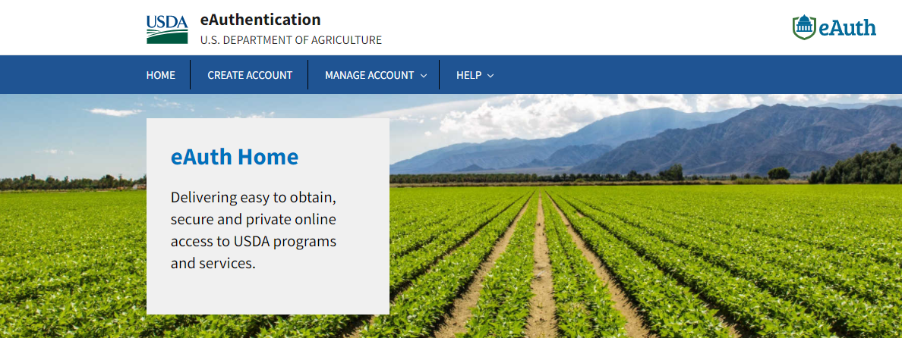
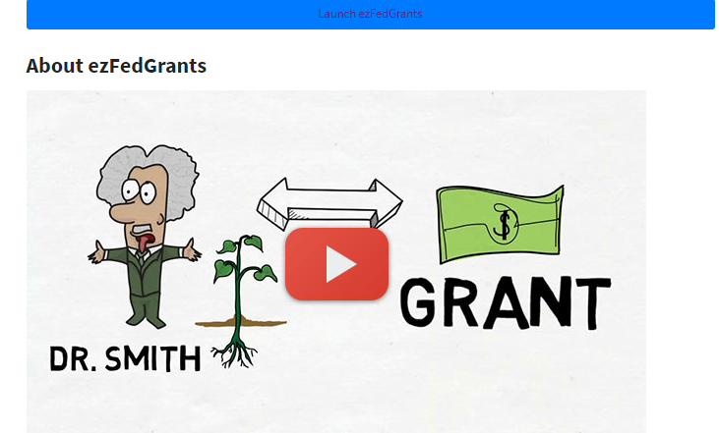
Must Register on ezFedGrants.gov (eFG)
Create an eAuth account
EzfedGrants.gov
https://www.eauth.usda.gov/eauth/b/usda/home

Slide 27
Need Assistance?
24/7 Grants.gov support
support@grants.gov
1-800-518-4726
Grants.gov webpage (https://www.grants.gov/web/grants/support.html)
eAuthentication Account Creation
Contact the eAuthentication Help Desk:
1-800-457-3642 (Option 1)
eAuthHelpDesk@ftc.usda.gov
EzfedGrants questions
Help Desk at ezFedGrants-cfo@usda.gov.
External User Onboarding- https://nfc.usda.gov/FSS/Training/Online/ezFedGrants/Resources/JA-Onboarding_Quick_Reference.pdf

Slide 28
CONTACTS & RESOURCES

Slide 29
Outreach Resources
An outreach resources website has been established for the LFPA program that includes:
  Resources for states and tribes
  Resources for socially disadvantaged producers
  https://www.ams.usda.gov/selling-food-to-usda/lfpacap/outreach-resources

Slide 30
For more information
LFPA website
https://www.ams.usda.gov/selling-food-to-usda/lfpacap
Additional questions
LFPA@usda.gov

