Slide 2
Perishable Agricultural Commodities Act (PACA) Working in partnership with the fruit and vegetable industry, PACA facilitates fair trade practices through education, mediation, arbitration, licensing and enforcement.

Slide 3
PACA Provides
PACA provides:
A forum to investigate, mediate, and arbitrate contract disputes;
A mechanism for recovering damages when buyers and sellers of produce fail to meet their contractual obligations;
Provisions to sanction produce sellers that fail to pay obligations or misrepresent the products they are selling;
A mechanism to monitor the activities of PACA violators.

Slide 4
PACA Highlights - 2021
PACA Highlights - 2021
PACA maintained over 13,100 active licensees.
PACA assisted 1685 callers with produce transactions valued at over $46.4 million through calls to the PACA “good delivery” line.
PACA suspended the licenses of 54 produce firms and imposed sanctions or employment restrictions for failure to pay more than $2.9 million for multiple shipments of produce.
PACA opened 780 new informal reparation complaints involving $38.8 million.

Slide 5
PACA Highlights – 2021 cont
PACA Highlights - 2021
PACA had another successful year assisting parties in settling approximately 90 percent of informal complaints within four months;
PACA conducted a large-scale industry pulse-check, contacting over 850 individuals across the produce industry. PACA asked stakeholders whether it was currently meeting the needs of the industry and sought input on how PACA should prepare to meet future needs and challenges of the industry.
Industry feedback was positive and indicated satisfaction with the services provided by PACA.

Slide 6
ePACA
ePACA
The ePACA portal is available 24/7 to apply for or renew a PACA license or to file a PACA complaint online. About 25 percent of PACA licensees are submitting their license applications through the ePACA portal.
ePACA’s “PACA Search” function provides real-time information on a company’s PACA license status and complaint history, assisting the industry in making informed business decisions;
The ePACA mobile app provides access to PACA search capabilities on mobile devices.

Slide 7
PACA Priorities
PACA Priorities
To continue to provide the highest level of customer service;
To address the needs and concerns of industry stakeholders;
To expand PACA’s presence in the industry through outreach efforts;
To maintain an emphasis on PACA licensing, ensuring compliance with the law.

Slide 8
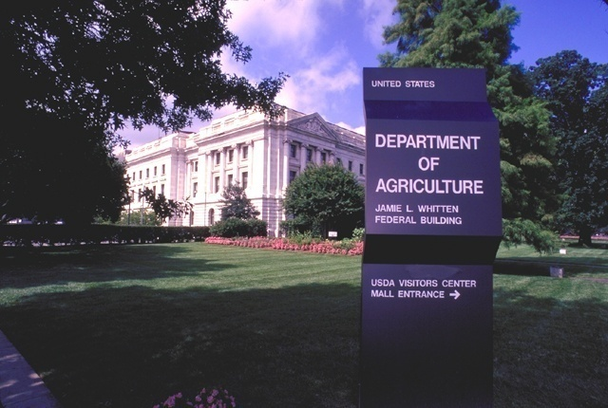
000
Perishable Agricultural Commodities Act
(PACA)
1-800-495-7222
www.ams.usda.gov/paca

