Slide 1
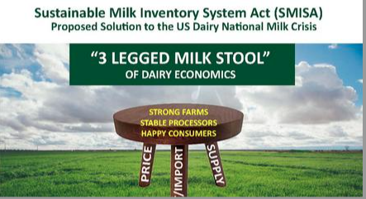
Testimony of Mark McAfee before the USDA FMMO Hearing Dairyman, VP & Board Member California Dairy Campaign
October 6th 2023
Home of Growth Management
Member / Sponsor IMGC

Slide 2
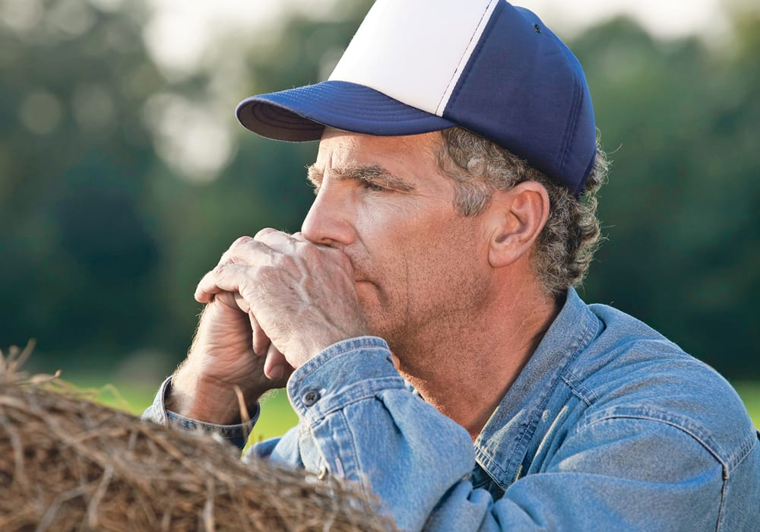
This just in last night!
A search by Farm Bureau, NFO and others to try and get dairymen to testify at this USDA FMMO hearing. ( source Dairy Together CFU WFU NFU )
None would volunteer for fear of retaliation by Processors.
Dairy farmers are scared and live in fear of processors and loss of contracts

Slide 3
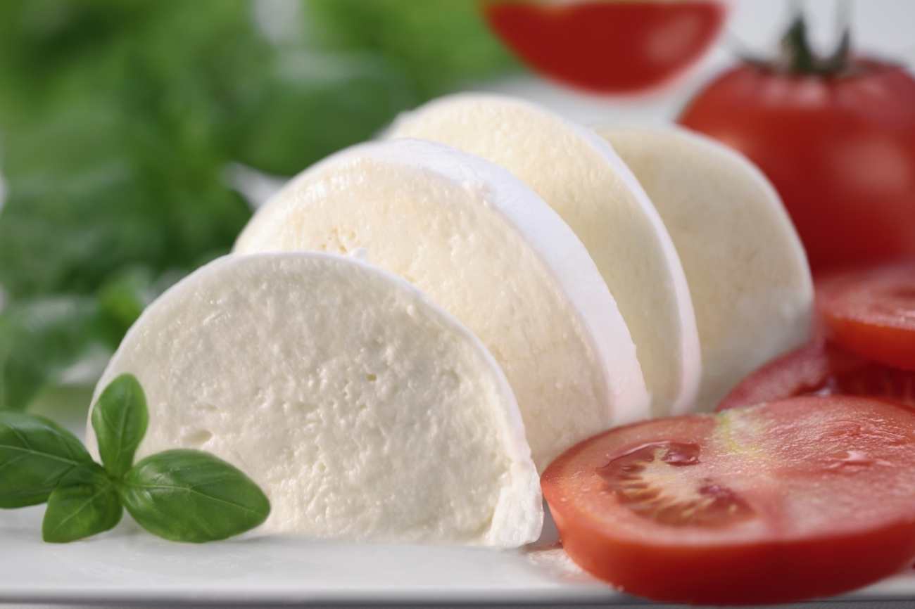
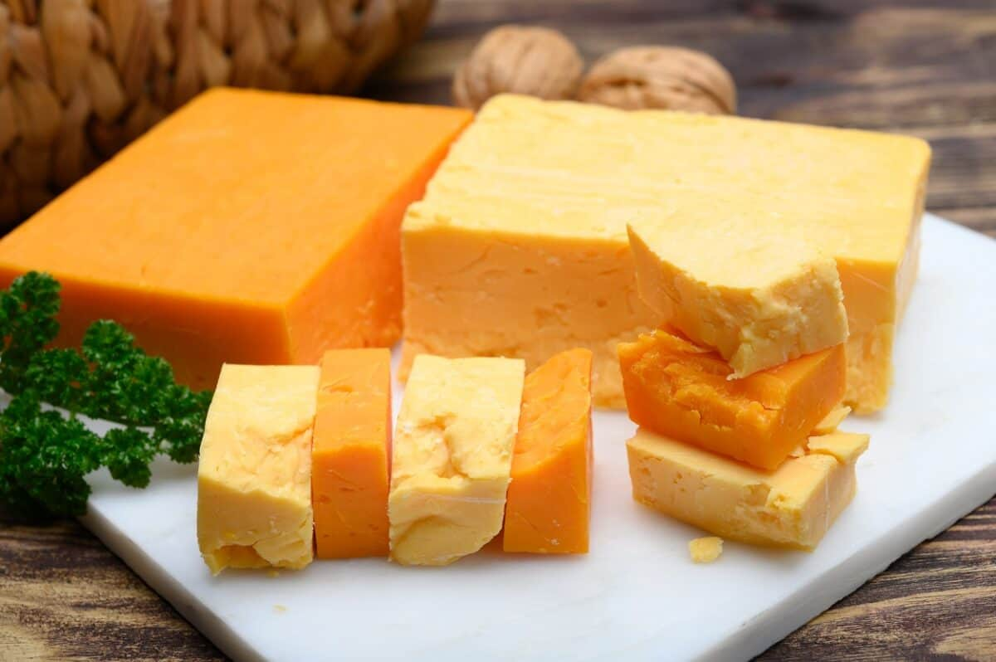
I strongly support the testimony of Lynne McBride and Joaquin Contente of the CDC
Include Mozzarella in the Class 3 price formula
Mozzarella ( 4.49 billion pounds) is now much larger than cheddar cheese
( 3.96 billion pounds ) in the USA but it is not used in the Class 3 formula. The moisture levels are much higher. If added to the pricing formula, farmers would be paid a much higher price. It is being ignored and overlooked.
m
Che
Mozzarella
Cheddar

Slide 4
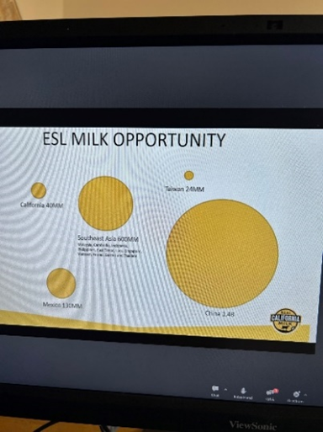
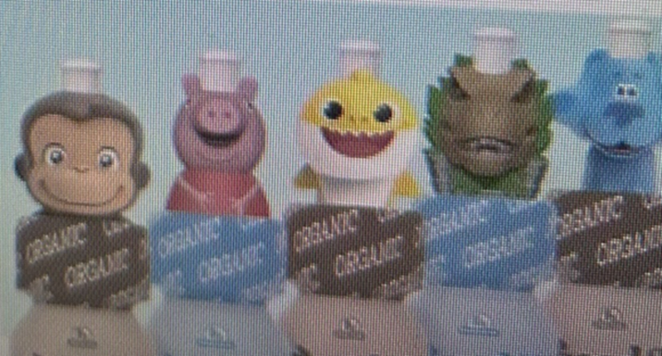
Milk research points to “high value” for dairy products
Processors don’t follow the research that is funded by dairy check off dollars. Total disconnect!
Consumer Market research says: less processed, easy to digest, delicious, gut friendly, immune system building dairy products. “Keep the milk bio-actives bioactive”.
Processors respond: highly processed “shelf stable ESL products”, hard to digest, gut inflammatory, allergenic, have added sugar, with cartoons on them.
Science says: We can make easy to digest, bioactive, less processed, delicious dairy products that are gut friendly, and build the gut microbiome which is home to 80% of the human immune system.

Slide 5
We have the answers, but processors don’t listen or innovate!
Latest IMGC study, there is “no lactose intolerance”. ( Cork Ireland, Lemay 2023 )
Instead, there is a loss of biodiversity in dairy products and in consumers guts.
The Maasai and Mongolians are proof.
“ Pasteurization Intolerance?”
It’s the processing not the consumers
Where is the innovation??
HPP, UV, Ultrafiltration,
HACCP, PCR testing and less or unprocessed

Slide 6
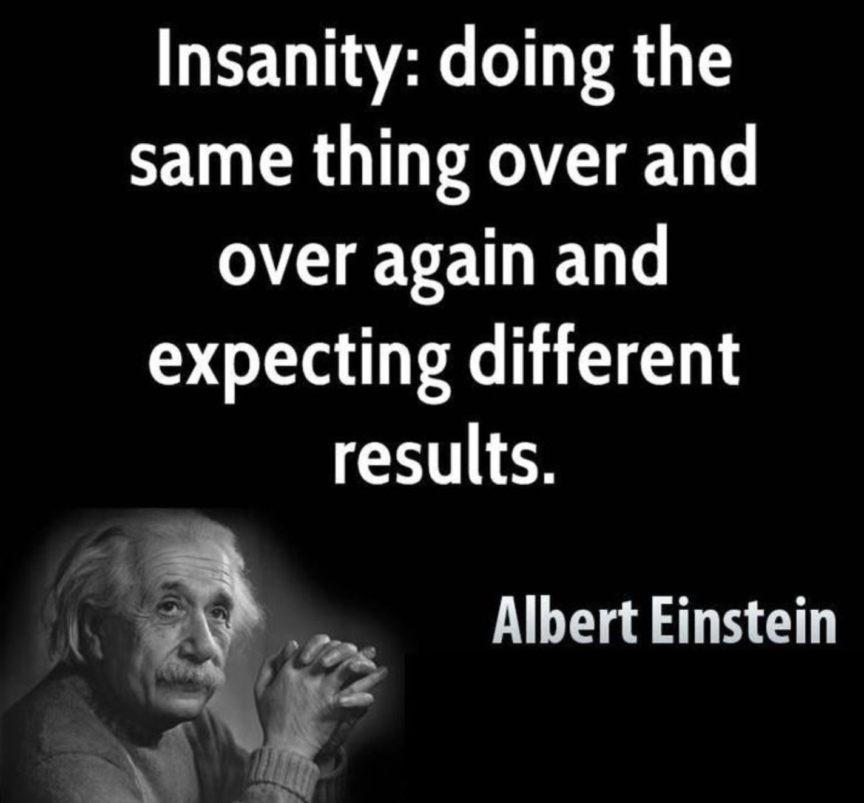
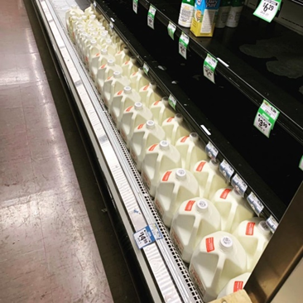
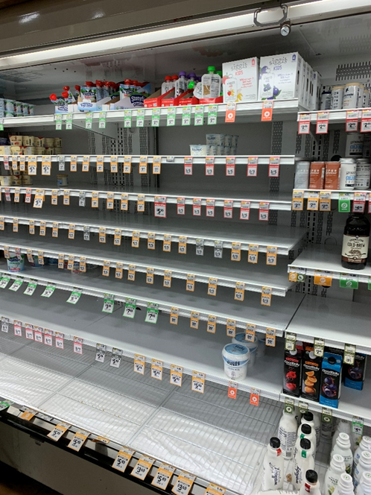
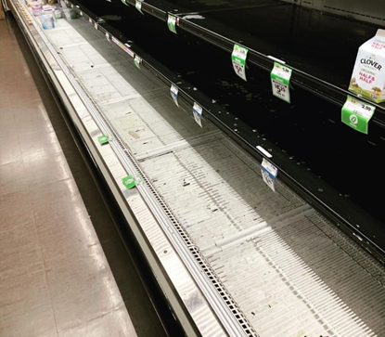
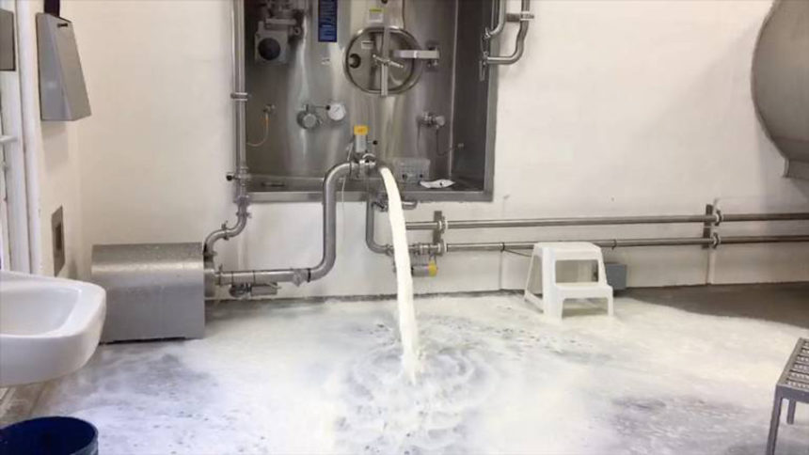
Consolidation is a national food security issue
The 2020 “Food Chain Stress Test” served us a Lesson.
Did we learn or listen? Do we want a fragile food system?
Local brands served people
example by Raw Farm
2020 Big processing plants could not adapt.
Empty store shelves for months
Dairies dumping milk 2020

Slide 7
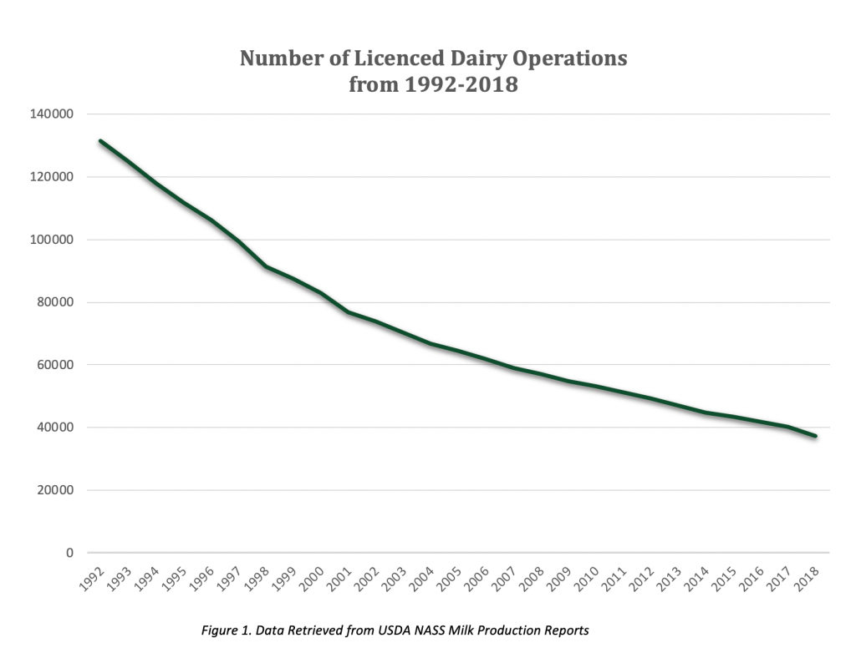
We have lost 103,000 dairies since 1992
We are losing 5 dairies every day…plus:
Resilience and ability to adapt
Local and regional milk sources
Creating a more fragile food chain
Jobs and community tax base support
Carbon heavy fragile long distance food chain
Processors want a higher “make allowance subsidy” with guaranteed profit margins
as a reward for lack of innovation and failing the American Dairies and American Consumers

Slide 8
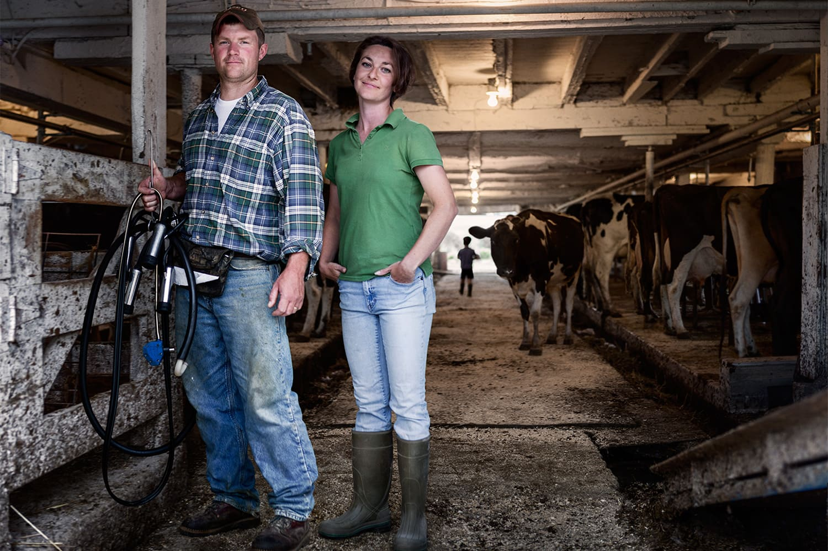
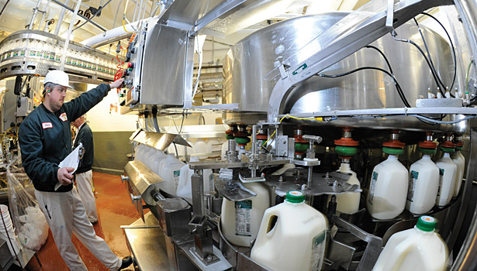
Things we can do today to build a stronger dairy system for America
Listen to the consumers! Market data points the way to growth and success.
Listen to microbiome science and innovate! Processors “make allowances” assure more of the same.
Fairly pay the farmers to “match growth in supply with growth in demand”.
Teach about dairy products using influencers on social platforms, but…first…create the innovative, gut friendly, delicious, bioactive products that influencers would be excited about.
Add Mozzarella to the Class 3 pricing formula.
A stronger dairy system must serve the entire food chain
Farmers Processors Consumers Health

