Slide 1
Specialty Crops Procurement Division
2025 Industry Meeting
January 29, 2025

Slide 2
Agenda
12:00 – 12:10: Opening Remarks/Welcome David C. Jackson, Division Director, Specialty Crop Procurement Division
12:10 – 12:20: Commodity Procurement Program Overview Glenn Reid, Branch Chief, Vegetable Branch & Pulses Branch Kelli Dawkins, Branch Chief, Fruit and Tree Nuts
12:20 -- 12:30: Introduction of Team Members
12:30 – 1:00: DOV Audits Linda Staten Specialty Crop Inspection
1:00 – 1:05: Break
1:05 – 1:20: Seals and Bill of Lading Genesys Corrado, Contract Specialist, Fruit and Tree Nuts, Cedric Hopkins, Contract Specialist, Vegetables & Beans
1:20 – 1:30 Q&A/Closing Remarks David C. Jackson, Division Director, Specialty Crop Procurement Division Page 1
Notes:
In order to keep PDFs exported from this PowerPoint as 508 compliant as possible, use the existing text boxes and photo placeholders. Avoid drawing new text boxes and inserting photos willy-nilly; doing so changes the reading order, requiring extra time to fix. Thanks for helping us be more accessible to everyone.
Photos you use should have alternative text. Here’s how to add it:
Select the photo; you should see an overall outline appear.
Right-click the outlined photo and select ‘Edit Alt Text…’ towards the bottom.
Enter a title and description in the space provided. For a photo description, write a brief caption. To describe something more complex like a chart, pretend you’re explaining what the chart is showing to someone over the phone.

Slide 3

Housekeeping Items
Please direct all chat questions to:
Glenn Reid or Kelli Dawkins
Live Q&A is also available by clicking the
Notes:
In order to keep PDFs exported from this PowerPoint as 508 compliant as possible, use the existing text boxes and photo placeholders. Avoid drawing new text boxes and inserting photos willy-nilly; doing so changes the reading order, requiring extra time to fix. Thanks for helping us be more accessible to everyone.
Photos you use should have alternative text. Here’s how to add it:
Select the photo; you should see an overall outline appear.
Right-click the outlined photo and select ‘Edit Alt Text…’ towards the bottom.
Enter a title and description in the space provided. For a photo description, write a brief caption. To describe something more complex like a chart, pretend you’re explaining what the chart is showing to someone over the phone.

Slide 4
COMMODITY PROCUREMENT PROGRAM
Notes:
In order to keep PDFs exported from this PowerPoint as 508 compliant as possible, use the existing text boxes and photo placeholders. Avoid drawing new text boxes and inserting photos willy-nilly; doing so changes the reading order, requiring extra time to fix. Thanks for helping us be more accessible to everyone.

Slide 5
Commodity Procurement Program Overview
Glenn Reid Branch Chief
Vegetable and Pulses Branch
Kelli Dawkins Branch Chief
Fruit and Tree Nut Branch
Specialty Crops Procurement Division

Slide 6
Commodity Procurement Mission
AMS Commodity Procurement facilitates the marketing of 100% domestic agricultural products through the purchase of food for International and Domestic nutrition assistance programs…feeding the hungry around the world.

Slide 7
Federal Procurement Program
Federal Acquisition Regulations (FAR)
Agriculture Acquisition Regulations (AGAR)

Slide 8
Products Purchased
Domestic Nutrition Programs | International Nutrition Programs
Dairy | Bulgur
Beans Pkg/Canned | Corn Products
Fish | Dry Beans
Fruit Canned/Fresh/Frozen | Grain Products
Juice | Oil Products
Livestock | Peanut Products
Oil Products | Peas/Lentils
Peanut Products | Rice
Peas/Lentils
Poultry
Soups
Vegetables Canned/Fresh/Frozen

Slide 9
Programs Supported
Domestic Nutrition Programs | International Nutrition Programs
National School Lunch Program | Food for Peace
Child and Adult Care Food Program | McGovern-Dole Food for Education
Summer Food Service Program | Food for Progress
Nutrition Services Incentive Program
The Emergency Food Assistance Program
Commodity Supplemental Food Program
Food Distribution Program on Indian Reservations

Slide 10
Types of Purchases
Entitlement/Meal Package/Program Purchases
          Largely based on nutrition program recipient demand
          Procurement agent for USDA’s Food and Nutrition Service, U.S. Agency for International Development, USDA’s Foreign Agricultural Service and the Nutrition and Food Aid Programs they administer

Slide 11
Types of Purchases
Section 32
    Clause 2 of Section 32 of the Act of August 24,1935: “encourage the domestic consumption”
    AMS analyzes market conditions and recipient needs – “good product at a good price”
    Typically distributed to Food Banks

Slide 12
Types of Purchases
Disaster/Emergency
    Presidentially declared disasters within the United States or its territories
    Emergency food assistance around the world
      Conflict
      Natural disasters

Slide 13
Types of Purchases
Commodity Credit Corporation (CCC)
    CCC is a Government-owned and operated entity that was created to stabilize, support, and protect farm income and prices.
    CCC also helps maintain balanced and adequate supplies of agricultural commodities and aids in their orderly distribution.
    CCC Charter Act also authorizes the sale of agricultural commodities to other government agencies and to foreign governments and the donation of food to domestic, foreign, or international relief agencies.

Slide 14
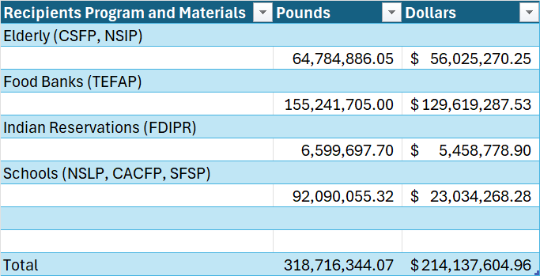
Fiscal Year 2024 Vegetable and Pulse Purchases
Notes:
In order to keep PDFs exported from this PowerPoint as 508 compliant as possible, use the existing text boxes and photo placeholders. Avoid drawing new text boxes and inserting photos willy-nilly; doing so changes the reading order, requiring extra time to fix. Thanks for helping us be more accessible to everyone.
Photos you use should have alternative text. Here’s how to add it:
Select the photo; you should see an overall outline appear.
Right-click the outlined photo and select ‘Edit Alt Text…’ towards the bottom.
Enter a title and description in the space provided. For a photo description, write a brief caption. To describe something more complex like a chart, pretend you’re explaining what the chart is showing to someone over the phone.

Slide 15
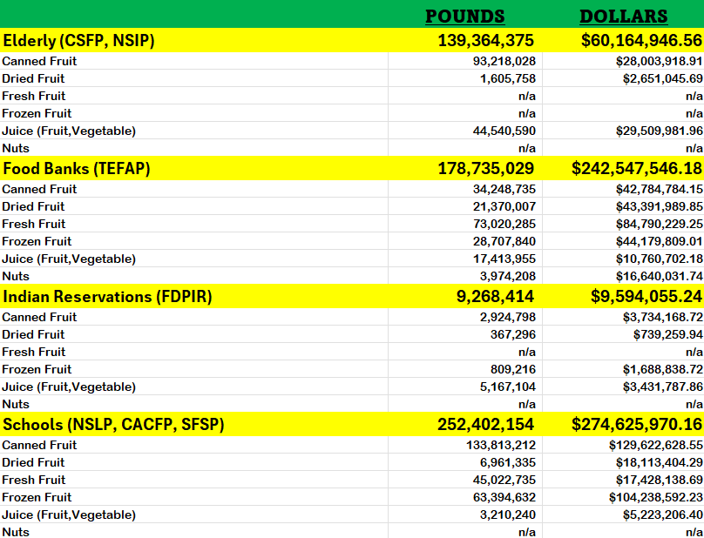
Fiscal Year 2024 Fruit & Tree Nut Purchases
Notes:
In order to keep PDFs exported from this PowerPoint as 508 compliant as possible, use the existing text boxes and photo placeholders. Avoid drawing new text boxes and inserting photos willy-nilly; doing so changes the reading order, requiring extra time to fix. Thanks for helping us be more accessible to everyone.
Photos you use should have alternative text. Here’s how to add it:
Select the photo; you should see an overall outline appear.
Right-click the outlined photo and select ‘Edit Alt Text…’ towards the bottom.
Enter a title and description in the space provided. For a photo description, write a brief caption. To describe something more complex like a chart, pretend you’re explaining what the chart is showing to someone over the phone.

Slide 16
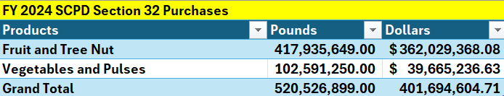
FY2024 Sec 32 Purchases
Notes:
In order to keep PDFs exported from this PowerPoint as 508 compliant as possible, use the existing text boxes and photo placeholders. Avoid drawing new text boxes and inserting photos willy-nilly; doing so changes the reading order, requiring extra time to fix. Thanks for helping us be more accessible to everyone.
Photos you use should have alternative text. Here’s how to add it:
Select the photo; you should see an overall outline appear.
Right-click the outlined photo and select ‘Edit Alt Text…’ towards the bottom.
Enter a title and description in the space provided. For a photo description, write a brief caption. To describe something more complex like a chart, pretend you’re explaining what the chart is showing to someone over the phone.

Slide 17
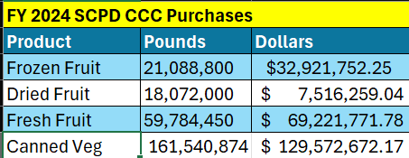
FY2024 CCC Purchases
Vegetables and Pulses, Fruit and Tree Nut
Notes:
In order to keep PDFs exported from this PowerPoint as 508 compliant as possible, use the existing text boxes and photo placeholders. Avoid drawing new text boxes and inserting photos willy-nilly; doing so changes the reading order, requiring extra time to fix. Thanks for helping us be more accessible to everyone.
Photos you use should have alternative text. Here’s how to add it:
Select the photo; you should see an overall outline appear.
Right-click the outlined photo and select ‘Edit Alt Text…’ towards the bottom.
Enter a title and description in the space provided. For a photo description, write a brief caption. To describe something more complex like a chart, pretend you’re explaining what the chart is showing to someone over the phone.

Slide 18
AMS Team Effort
CPP expertise is in Contracting
Rely upon other AMS Programs for agricultural market expertise
  Federal Grain Inspection Service
  Specialty Crop Inspections
Notes:
In order to keep PDFs exported from this PowerPoint as 508 compliant as possible, use the existing text boxes and photo placeholders. Avoid drawing new text boxes and inserting photos willy-nilly; doing so changes the reading order, requiring extra time to fix. Thanks for helping us be more accessible to everyone.
Photos you use should have alternative text. Here’s how to add it:
Select the photo; you should see an overall outline appear.
Right-click the outlined photo and select ‘Edit Alt Text…’ towards the bottom.
Enter a title and description in the space provided. For a photo description, write a brief caption. To describe something more complex like a chart, pretend you’re explaining what the chart is showing to someone over the phone.

Slide 19
Questions?
Contact Us
Agricultural Marketing Service
Commodity Procurement Program
1400 Independence Avenue, SW, S-0239
Washington, D.C. 20250-0239
Phone: 202-720-4517
CP Contact List (usda.gov)
Notes:
In order to keep PDFs exported from this PowerPoint as 508 compliant as possible, use the existing text boxes and photo placeholders. Avoid drawing new text boxes and inserting photos willy-nilly; doing so changes the reading order, requiring extra time to fix. Thanks for helping us be more accessible to everyone.
Photos you use should have alternative text. Here’s how to add it:
Select the photo; you should see an overall outline appear.
Right-click the outlined photo and select ‘Edit Alt Text…’ towards the bottom.
Enter a title and description in the space provided. For a photo description, write a brief caption. To describe something more complex like a chart, pretend you’re explaining what the chart is showing to someone over the phone.

Slide 20
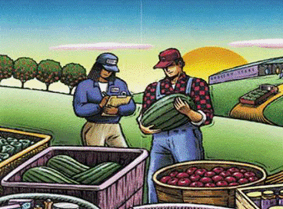
Domestic Origin Verification Audit Program (DOV)

Slide 21
Background
The AMS Commodity Procurement Division (CPD) under its commodity purchase program purchases a wide variety of agricultural food products.
These purchases are used:
To support the National School Lunch Program in addition to other food assistance programs.
To help stabilize prices in US agricultural commodity markets by balancing supply and demand.

Slide 22
Requirement
The Commodity Procurement Division requires all vendors through contract to supply 100 percent U.S. origin commodities to USDA .
To qualify all products and product components shall have originated entirely from crops grown, processed, and packed in the United States, its territories or possessions, the Commonwealth of Puerto Rico, or the Trust Territories of the Pacific Islands.

Slide 23
Requirement
To demonstrate compliance with the domestic origin requirement, each contractor, subcontractor, supplier, or processor that provides a component or product to USDA is required to either:
perform a trace-back of at a minimum one code, per facility, per purchase order, for each commodity provided on the USDA purchase order
or
participate in the DOV Audit Program

Slide 24
Purpose of the DOV Program
The DOV Program is an audit-based program developed to replace the requirement to trace every contract.
Applicants should already have a system or procedures in place to meet the current domestic origin contract requirement.
The DOV program provides a means for the applicant to use these procedures to develop an auditable process to verify the domestic origin of the product sold to the USDA.

Slide 25
Advantages of Program Participation
Decreases the number of traces required to be submitted to the USDA and any redundancies.
Assists applicants in demonstrating continual improvement of their verification procedures.
Compliance with the domestic origin requirement can be assured prior to receipt of components or products from suppliers.

Slide 26
Advantages of Program Participation
Once fully implemented, DOV can lead to increase in efficiency in facilities administrative operations.
Facilitates a reduction in overall costs by reducing the number of tracebacks required per contract, per product.

Slide 27
Who is eligible to participate?
Any financially interested applicant (contractor, subcontractor, supplier, or processor) providing components or products to the USDA may request the DOV Audit Program service.
The DOV Audit Program may be used whether or not the applicant handles imports, requests lot inspection, or receives in-plant inspection.

Slide 28
Contact the DOV Program Coordinator to discuss the DOV specific requirements and application process.
Contact information can be found at:
http://www.ams.usda.gov/DOV Complete the required Application for Service form
and submit to the DOV Program Coordinator.
How to apply to the program?

Slide 29
Applicant’s submit a DOV program manual detailing the verifiable written procedures used to ensure compliance with the domestic origin contract requirement along with specific DOV Program requirements.
(The DOV Quick Guide summarizes the specific DOV Program requirements and can be viewed at http://www.ams.usda.gov/DOV )
Along with the Application for Service

Slide 30
Pre-Validation Assessment
The Applicant’s DOV program is assessed based on the documented procedures and processes submitted.
Auditor then provides feedback on any elements within the applicant’s submitted DOV program that may require additional clarification or information prior to the On-site Validation Audit.

Slide 31
Validation Audit
Audit Coordinator:
Completes the Pre-validation Assessment process and deems the applicant ready for the on-site validation audit.
Assigns competent auditor(s) to conduct the validation audit and discuss any nonconformance with the applicant.

Slide 32
Validation Audit
If any non-conformances are found:
Written Corrective Action Requests (CAR) are provided to the applicant.
The applicant is then required to submit written responses to the CAR requests.
When all the corrective actions are determined adequate, the applicant is an:
Approved DOV Program Participant.

Slide 33
If an applicant is unable to be approved as a DOV Program Participant, the applicant is required to continue to submit trace-backs for every contract and commodity for the facility audited .
Validation Audit

Slide 34
Verification Audits
At least one on-site audit per year is required to ensure continued compliance with program requirements and approval in the DOV Program.
Increased frequency of Verification Audits
is dependent upon USDA’s assessment of the risk of non-compliance of the applicant’s program combined with verification audit findings.

Slide 35
Verification audits are considered compliant and DOV program approval is maintained when no audit deficiencies are found or adequate corrective action is taken in response to audit deficiencies.
Verification Audits

Slide 36
Benefits of Participation
trace-back for every contract is no longer needed.
trace-back requirements are met during audit.
greatly reduces the paperwork of numerous traces.
alleviates the redundancy of trace-back on the same product used for multiple contracts.
Compliance with the origin requirement is established prior to production rather than traced- back after production.

Slide 37
Benefits of Participation
Approved DOV Program Participants are listed on the USDA website.
Contractors can select suppliers from the approved list and be assured that the supplier is able to meet the domestic origin requirement prior to contracting with them.
Eliminates any contractor concern regarding the ability of the supplier to provide trace documentation after delivery to the contractor.

Slide 38
Summary
DOV is an audit based program and is an option to the current trace-back requirement.
DOV improves the way domestic origin is verified.
Approved DOV Program Participants can be
listed on the Specialty Crop Inspection Division websites.

Slide 39
Summary
DOV Audit Program participation decreases paperwork, trace-backs, and redundancy.
Any applicant can participate – contractor, subcontractor, supplier, or processor.
Program participation enhances the management of domestic origin verification.

Slide 40
RESOURCES
Complete DOV Audit Program information is available at: http://www.ams.usda.gov/DOV
Application for Service form
DOV Audit Program General Policies and Procedures
DOV Quick Guide
Audit Report form
List of Approved DOV Program Participants
Audit rate information

Slide 41
AGRICULTURAL MARKETING SERVICE
COMMODITY PROCUREMENT PROGRAM
Notes:
In order to keep PDFs exported from this PowerPoint as 508 compliant as possible, use the existing text boxes and photo placeholders. Avoid drawing new text boxes and inserting photos willy-nilly; doing so changes the reading order, requiring extra time to fix. Thanks for helping us be more accessible to everyone.

Slide 42
Introduction
Genesys Corrado
Contract Specialist
Commodity Procurement, Domestic Programs
Fruit & Tree Nut Branch
Tree Nuts & Dried Fruit and Nut Mix
Cedric Hopkins
Contract Specialist
Commodity Procurement, Domestic Programs
Vegetables & Pulse Branch
Canned Dried Beans
Topics of Discussion: Bill of Lading & Seals

Slide 43
Ready to Deliver
(Time for ASN)
4A52.211-80
Once Contractor determines that they are ready to deliver the product a delivery appointment should be made.
Delivery Appointments should be requested no later than 72 hours prior to final delivery date on contract.
Now is time to enter the advanced shipment notice(ASN) in WBSCM. This can be done immediately following the confirmation of appointment on or before the date of shipment but not less than 24 hours prior to delivery.
The Contractor must provide accurate information when creating the ASN. The ASN provides an alert to the appropriate recipient agency that the product will be shipped for a sales order
Please keep in mind that entering an ASN is the first step in ensuring payment for delivery

Slide 44
Secured Delivery Appointment with recipient
Entered ASN into WBSCM
Now Time to Deliver…But First….Let’s Not Forget About SEALS

Slide 45
Seals on Transportation Conveyance
4A52.247-83
Requirements:
Suppliers of commodities, products and/or services under the supervision of a USDA-AMS certification agent (when applicable) shall be responsible for placing a seal(s) on all cargo doors of each truck upon completion of loading, partial unloading, inspection, or servicing.
Seals must meet the American Society for Testing and Materials (ASTM) Standard, and/or the International Organization for Standards.
Required to use traceable, tamper-evident commercial seals (ex. flat metal, wire, plastic, etc) or high security seals (high security bolt, barrier-type, or equivalent device which can only be removed by bolt cutter type tools)
Seals shall be sequentially numbered.

Slide 46
Seals on Transportation Conveyance
4A52.247-83
Vendor or its agent shall provide a sufficient number of traceable tamper-evident seals to ensure security of the load while in route through final destination (keep in mind multi-stop loads).
Seal numbers shall be documented on the BOL and shipment manifest, certificate, or other delivery documents which must be signed by the carrier or its agent.
The seal number must be recorded on the appropriate delivery document and must match with the applied seal at the time of arrival at the next destination.
When making multi-stop deliveries from the same railcar, the quantities required at each stop off must be placed in separate compartments under seal.

Slide 47
Seals on Transportation Conveyance
4A52.247-83
The following meet acceptable seal criteria:

Slide 48
Seals on Transportation Conveyance
4A52.247-83
When does a seal cause a delivery rejection?
Deliveries will be rejected, when seals have not been used to secure all cargo doors, if:
• The seal listed on the BOL does not match the seal number recorded on the BOL;
• The seal is broken;
• The seal is missing, or
• The seal has been removed prior to the transportation conveyance reaching its unloading point.
The seal does not meet the requirements listed in the master solicitation.

Slide 49
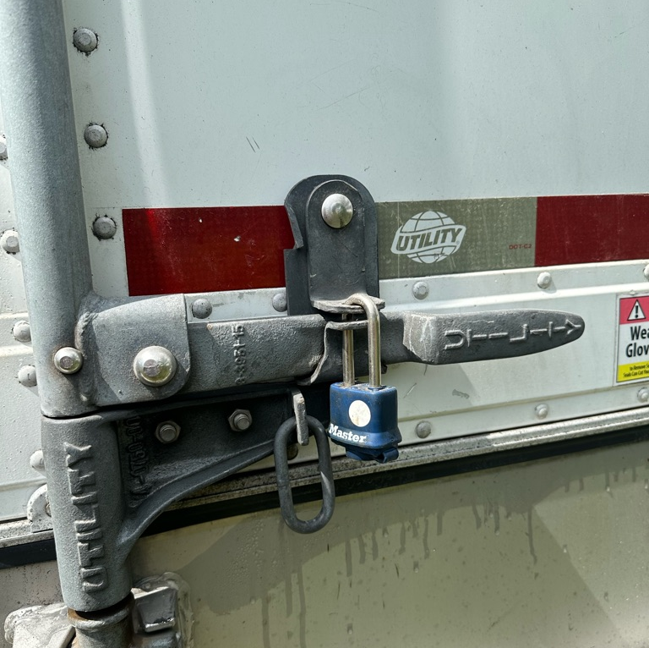
Seals on Transportation Conveyance
4A52.247-83
This seal does meet acceptable seal criteria in the master solicitation; the truck doors have a padlock.
Notes:
In order to keep PDFs exported from this PowerPoint as 508 compliant as possible, use the existing text boxes and photo placeholders. Avoid drawing new text boxes and inserting photos willy-nilly; doing so changes the reading order, requiring extra time to fix. Thanks for helping us be more accessible to everyone.
Photos you use should have alternative text. Here’s how to add it:
Select the photo; you should see an overall outline appear.
Right-click the outlined photo and select ‘Edit Alt Text…’ towards the bottom.
Enter a title and description in the space provided. For a photo description, write a brief caption. To describe something more complex like a chart, pretend you’re explaining what the chart is showing to someone over the phone.

Slide 50
Seal caused a rejection, what’s next?
A truck rejected due to a failed seal will only be accepted after a Condition of Container Inspection (COC) has been performed by AMS.
Additional information on Condition of Container Inspection can be found on the master solicitation dated 10/24/2024.
The Contractor is responsible for fees associated with a COC inspection.
Notes:
In order to keep PDFs exported from this PowerPoint as 508 compliant as possible, use the existing text boxes and photo placeholders. Avoid drawing new text boxes and inserting photos willy-nilly; doing so changes the reading order, requiring extra time to fix. Thanks for helping us be more accessible to everyone.
Photos you use should have alternative text. Here’s how to add it:
Select the photo; you should see an overall outline appear.
Right-click the outlined photo and select ‘Edit Alt Text…’ towards the bottom.
Enter a title and description in the space provided. For a photo description, write a brief caption. To describe something more complex like a chart, pretend you’re explaining what the chart is showing to someone over the phone.

Slide 51

Seal looks good
Delivery is being made.
While Delivering please ensure to have a Bill of Lading completed.
Notes:
In order to keep PDFs exported from this PowerPoint as 508 compliant as possible, use the existing text boxes and photo placeholders. Avoid drawing new text boxes and inserting photos willy-nilly; doing so changes the reading order, requiring extra time to fix. Thanks for helping us be more accessible to everyone.
Photos you use should have alternative text. Here’s how to add it:
Select the photo; you should see an overall outline appear.
Right-click the outlined photo and select ‘Edit Alt Text…’ towards the bottom.
Enter a title and description in the space provided. For a photo description, write a brief caption. To describe something more complex like a chart, pretend you’re explaining what the chart is showing to someone over the phone.

Slide 52

A Bill of Lading is required for proper approval of an electronic invoice.
The Bill of Lading should be signed by the recipient at the time of delivery
It is the vendor’s responsibility to ensure that a signed BOL is obtained, this will serve as your proof of delivery.
Section 4A52.247-82 of the master Solicitation lists the requirements of what data the BOL should include.
The BOL will serve as the goods receipt which should be uploaded to WBSCM.

Slide 53
Bill of Lading
4A52.247-82
Acceptable
Unacceptable
Purchase Order Number
Sales Order Number
Line Item Number
Description of Materials Delivered
Recipient name and signature
Date received
Quantity received
Seal number
Doesn’t list the sales Order Number
Doesn’t List the name of the recipient
Doesn’t include Date received
Doesn’t have recipient signature
Doesn’t have quantity received

Slide 54
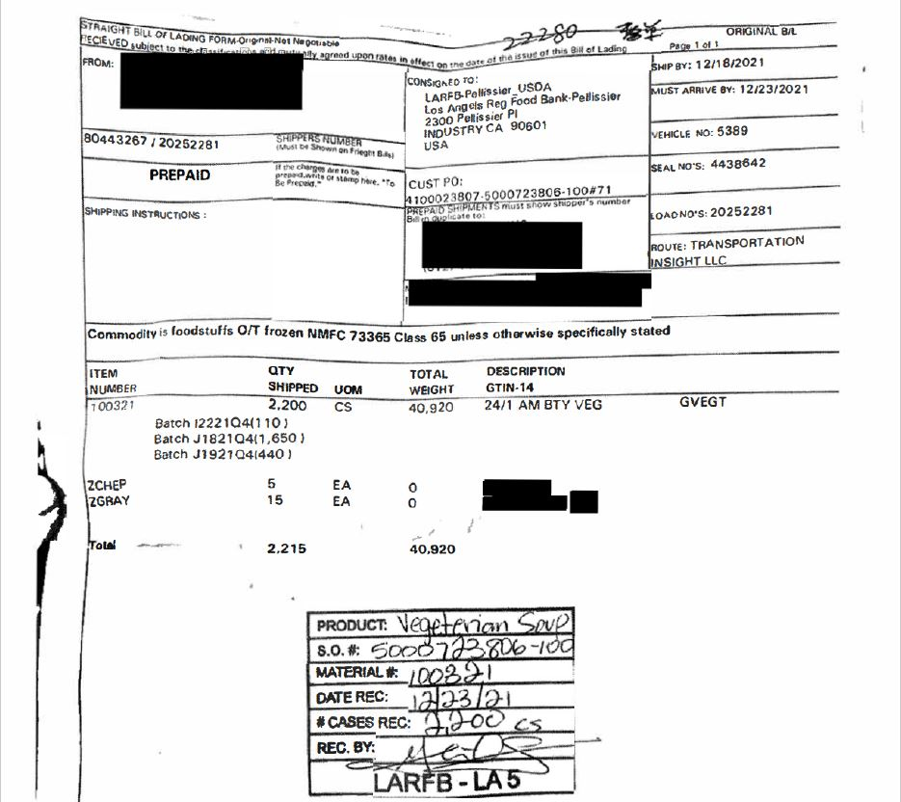
Example of Approved BOL

Slide 55
This BOL was Rejected. Recipient signature, date received, cases received were not included.

Slide 56

Path to successful BOL submission and approval:
Follow all steps required in WBSCM
Submit all required documentation
Review quantities and liquidated damages (if applicable)
Ensure POD/BOL are signed/dated, include quantity received along with noted damages (if applicable)

Slide 57
Key Points
It is the vendors responsibility to ensure that the carrier delivers with proper seals.
Proper seals are required on all trucks on all delivery stops.
An improper seal will result in rejection of load.
Rejected loads will require a new COC inspection; the Contractor will be held responsible fees incurred as a result of COC inspection.
ASN Must have accurate information entered when inputting into WBSCM.
Ensure that the Bill of Lading includes the Purchase Order Number, Sales Order Number, Line Item Number, Description of Materials Delivered, Recipient name and signature, date received, quantity received, seal number.
Issues can be reported to your contract specialist for further guidance.

Slide 58
Resources:
AMS Master Solicitation for Commodity Procurement – Domestic Programs (MSCP-D) https://www.ams.usda.gov/sites/default/files/media/MSCP.pdf
Conditions of Container Inspections arrangements are available by accessing the AMS website
at: https://www.ams.usda.gov/services/sci-contacts
Please select AMS Federal Inspection Offices at:
https://www.ams.usda.gov/services/sci-contacts/field-inspection-offices
If you need any assistance on the eINV process, please reach out to your assigned Contract Specialist or the WBSCMAMSHelpDesk@usda.gov
Video:
How to Modify a Goods Receipt and Submit an Electronic Invoice - YouTube
https://www.youtube.com/watch?v=A3eYN_vO72I

Slide 59
Questions?
Contact Us:
Agricultural Marketing Service
Commodity Procurement Program
1400 Independence Avenue, SW, S-0239
Washington, D.C. 20250-0239
Phone: 202-720-4517
CP Contact List (usda.gov)
Notes:
In order to keep PDFs exported from this PowerPoint as 508 compliant as possible, use the existing text boxes and photo placeholders. Avoid drawing new text boxes and inserting photos willy-nilly; doing so changes the reading order, requiring extra time to fix. Thanks for helping us be more accessible to everyone.
Photos you use should have alternative text. Here’s how to add it:
Select the photo; you should see an overall outline appear.
Right-click the outlined photo and select ‘Edit Alt Text…’ towards the bottom.
Enter a title and description in the space provided. For a photo description, write a brief caption. To describe something more complex like a chart, pretend you’re explaining what the chart is showing to someone over the phone.

Slide 60
Fruit and Tree Nut Branch
Name | Phone # | Email address | Materials
Kelli Dawkins | 816-926-2112 | Kelli.Dawkins@usda.gov | Branch Chief
Samantha Klagenberg | 816-648-9663 | Samantha.Klagenberg@usda.gov | Team Lead/Sr Contracting Officer
Ashley Train | 202-937-4905 | Ashley.Train@usda.gov | Team Lead/Sr Contracting Officer
Travis Hentzy | 301-851-3032 | Travis.Hentzy@usda.gov | IDIQ Seasonal Fruit/Canned Fruit
Kimberly Mason | 816-648-9664 | Kimberly.Mason2@usda.gov | Dried Fruit
Genesys Corrado | 202-690-3138 | Genesys.Corrado@usda.gov | Tree Nuts/Dried Fruit & Nut Mix
Sergey Tollenaar | 301-851-3031 | Sergey.Tollenaar@usda.gov | Frozen Fruit
Samantha Rech |  | Samantha.Rech@usda.gov | Frozen Juice/Bottled Juice
Nick Wiber | 202-720-9771 | Nick.Wiber@usda.gov | Fresh Fruit (Stone Fruit, Apples, Pears, Table Grapes)
Savannah Metoyer | 301-851-3029 | Savannah.Metoyer@usda.gov | Bulk Apples/Citrus
Nick Cavazos | 970-416-4691 | Nicholas.Cavazos@usda.gov | IDIQ Seasonal Fruit/Canned Fruit/Frozen Fruit
Notes:
In order to keep PDFs exported from this PowerPoint as 508 compliant as possible, use the existing text boxes and photo placeholders. Avoid drawing new text boxes and inserting photos willy-nilly; doing so changes the reading order, requiring extra time to fix. Thanks for helping us be more accessible to everyone.
Photos you use should have alternative text. Here’s how to add it:
Select the photo; you should see an overall outline appear.
Right-click the outlined photo and select ‘Edit Alt Text…’ towards the bottom.
Enter a title and description in the space provided. For a photo description, write a brief caption. To describe something more complex like a chart, pretend you’re explaining what the chart is showing to someone over the phone.

Slide 61
Vegetables and Pulses Branch
Name | Phone # | Email address | Materials
Glenn Reid | 202-997-0859 | Glenn.reid@usda.gov | Branch Chief
Douglas Stickler | 202-321-0026 | Douglas.Stickler@usda.gov | Team Lead/Sr Contracting Officer
Vacant |  |  | Team Lead/Sr Contracting Officer
Carol Givens-Verser | 816-823-1153 | Carol.Givens-Verser@usda.gov | Tomato Products
Luma Kale | 202-260-8939 | Luma.Kale@usda.gov | Seasonal Vegs; Tomatoes-Diced/Canned; White Potatoes; Veg Mix; Frozen Carrots
Blanca Ochoa | 202-720-3343 | Blanca.Ochoa@usda.gov | Sweet Potatoes Canned, Pumpkin, Spinach Canned, Hominy Canned
Claudius Price | 816-823-2485 | Claudius.L.Price@usda.gov | Frozen Vegs; Frozen Potatoes; Butternut Squash; Sweet Potatoes; Dehy Potatoes
Cedric Hopkins | 202-720-7106 | Cedric.Hopkins@usda.gov | Canned Beans
Christopher Edwards | 816-926-6976 | Christopher.Edwards3@usda.gov | HHP Dry Beans; Bulk Beans; Dry Lentils
Christa Banet | 512-383-2429 | Christa.Banet@usda.gov | IDIQ Seasonal Vegs, Stir Fry, Black Bean Burger, Canned Carrots & Kosher NSLP
Lacey Lopez |  | Lasey.brittonlopez@usda.gov | TBD
Notes:
In order to keep PDFs exported from this PowerPoint as 508 compliant as possible, use the existing text boxes and photo placeholders. Avoid drawing new text boxes and inserting photos willy-nilly; doing so changes the reading order, requiring extra time to fix. Thanks for helping us be more accessible to everyone.
Photos you use should have alternative text. Here’s how to add it:
Select the photo; you should see an overall outline appear.
Right-click the outlined photo and select ‘Edit Alt Text…’ towards the bottom.
Enter a title and description in the space provided. For a photo description, write a brief caption. To describe something more complex like a chart, pretend you’re explaining what the chart is showing to someone over the phone.

Slide 62
Thank you!
Agricultural Marketing Service
Commodity Procurement Program
1400 Independence Avenue, SW, S-0239
Washington, D.C. 20250-0239
Phone: 202-720-4517
CP Contact List (usda.gov)

